Slide 1

Centers of Excellence and Expertise
Overview
September 2015

Slide 2
What are Centers?
Virtual organizations that leverage technology to bring work to the Center
Coordinated from a strategic location
Aligned by key industry sectors
Bring existing expertise together to authoritatively facilitate trade
Provide a single point of processing for participating importers
Serve as resource to the broader trade community and to CBP’s U.S. government partners
2

Slide 3
Why Centers?
Respond to the dynamic trade environment
Bring all of CBP expertise together on a single industry at the national level
Deliver greater consistency and harmonization
Align CBP processes with modern business practices
Enhance industry-based knowledge
Implement manage-by-account practices
Trade Complexity
3

Slide 4
Goals of Centers
Facilitate legitimate trade through effective risk segmentation
  Utilize account based methods to process trade
  Expand partnerships - move more importers to trusted trader status
  Develop and implement comprehensive strategies to manage risk
Increase industry-based knowledge within CBP
  Advance bi-directional education to raise industry knowledge
  Engage industry groups and key stakeholders
  Bring all of CBP’s expertise to bear on a single industry in a virtual environment
Enhance enforcement and address industry risks
  Leverage industry to identify issues of mutual interest to provide CBP with targeting, enforcement, and/or intelligence information – Trade Intelligence
  Coordinate enforcement efforts by industry to address unique risks
4

Slide 5
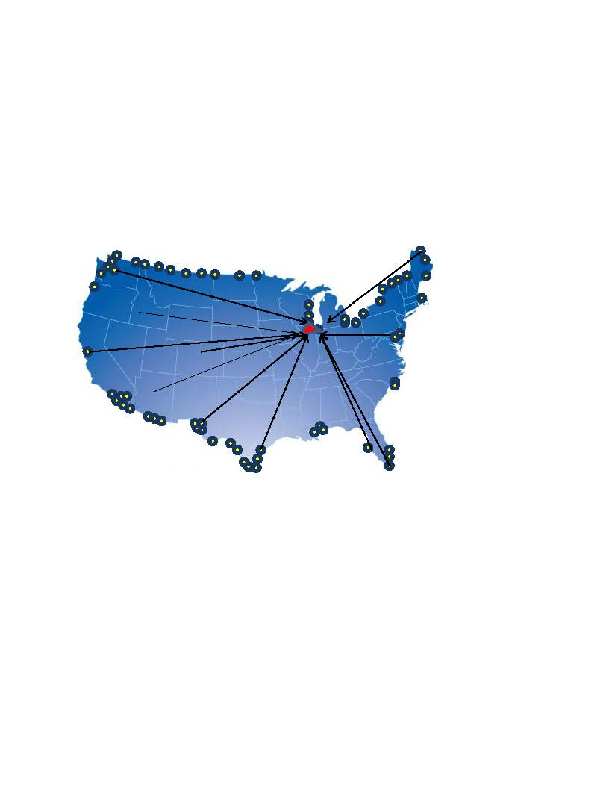
How Do Centers Operate?
Previously
  Company imports into 60 ports of entry
  60 ports conduct entry summary reviews
Centers
  Company imports into 60 ports of entry
  Single Center conducts entry summary reviews.
5

Slide 6
CEE Strategic Vision and End State
Centers will be integrated into every facet of the trade process, from pre-arrival to final liquidation
Pre-arrival, arrival, and cargo release
  Centers: trade admissibility risks and enforcement
  Port Directors: arrival and manifest processing; release authority for narcotics, terrorism, agriculture, and other security risks
Centers will perform all trade processing post-release
  Entry summary review/verification, liquidation, protest, reconciliation, drawback, liquidated damage and penalty initiation, commercial fraud case development, collaboration with HSI
Supply chain security
  Centers will partner with Supply Chain Security Specialists in basic supply chain management
Policy analysis
  Centers will provide subject-matter expertise to HQ policymakers on decisions affecting the Centers’ industry; ensure policy is executed uniformly
6

Slide 7
Benefits of Centers
7

Slide 8
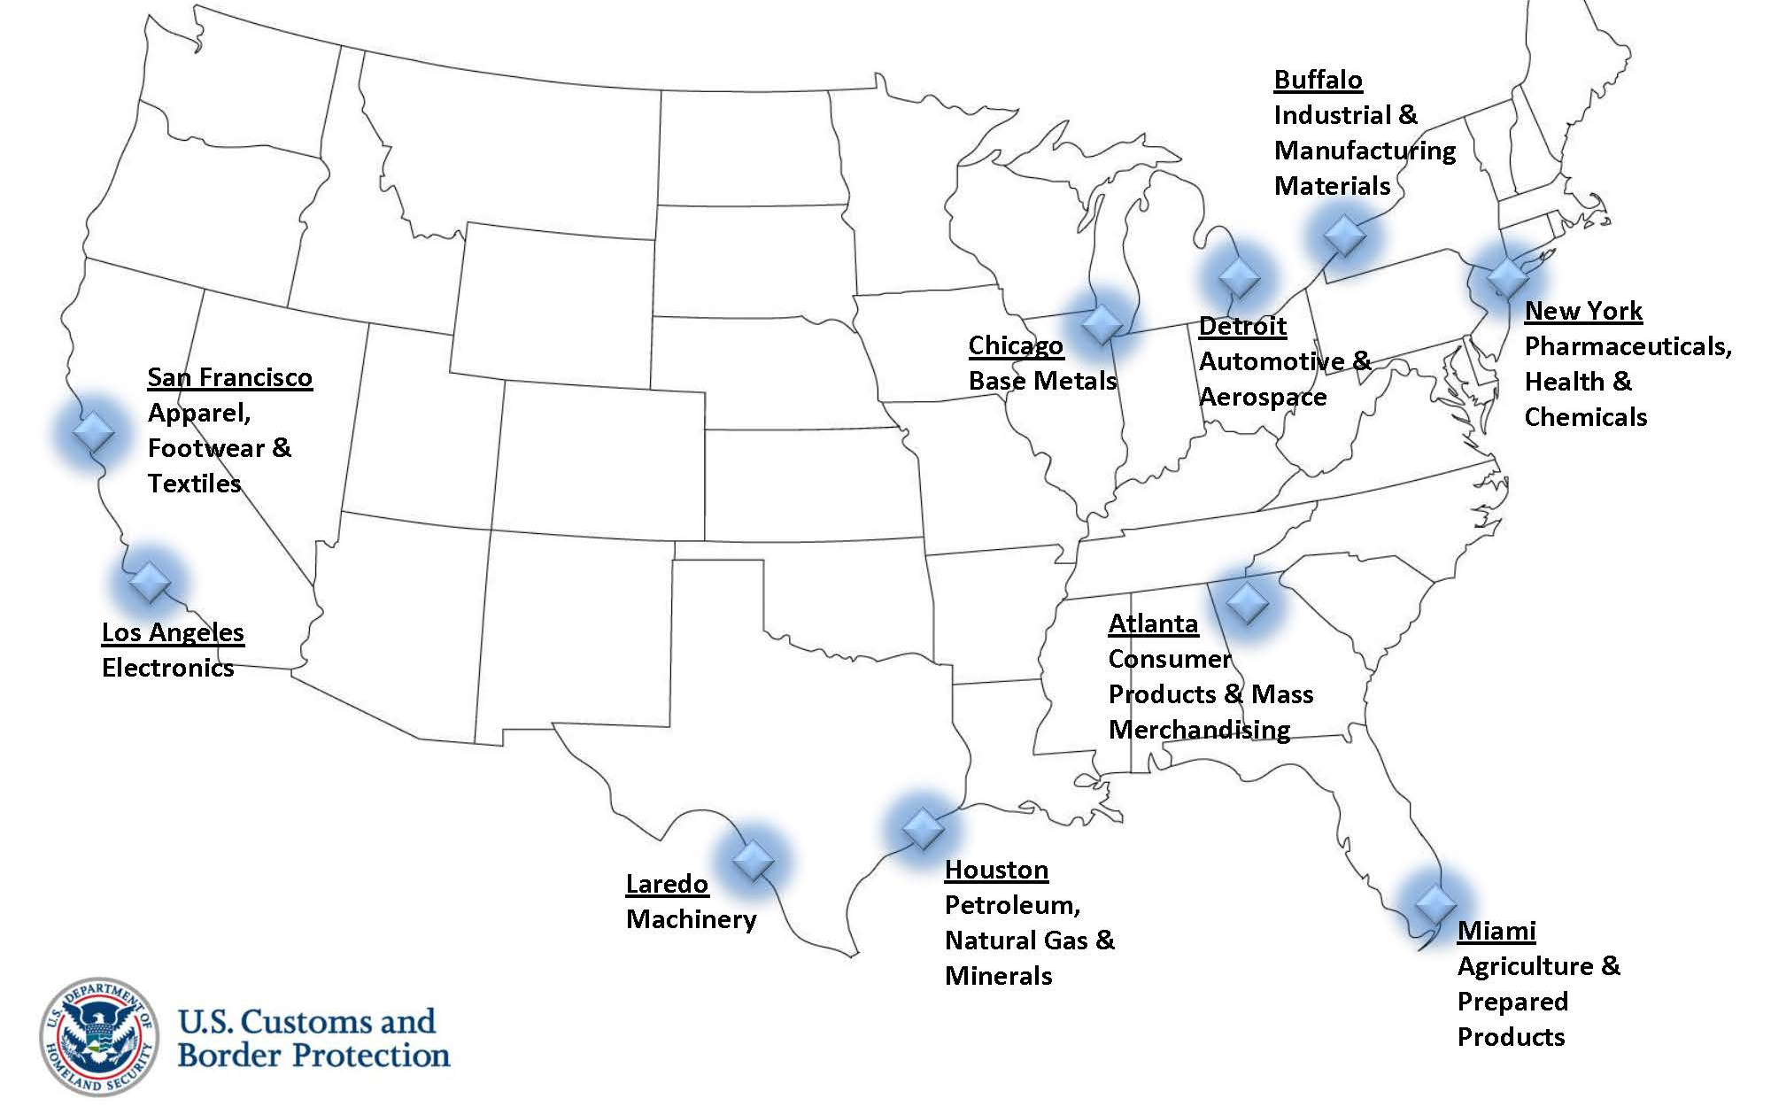
Ten Centers

Slide 9
Organizational Chart
Director Field Operations
Center Director
Assistant Director
Enforcement
Assistant Director
Validation & Compliance
Assistant Director
Partnership
The Enforcement Branch includes multidisciplinary teams that handle all enforcement issues for the industry.
The Validation & Compliance Branch includes multiple import specialist teams broken out by tariff assignments to handle all other importers within the industry.
  The Partnership Branch contains multidisciplinary teams that process the work of the participating partner and non-partner accounts. Teams are aligned by accounts.
9

Slide 10
100% Rollout Plans
Three CEEs have expanded, by Field Office, to 100% operations in Fiscal Year 2015
All entry summary and post-entry work processed by import specialists transitioned to the CEE by location, along with designated import specialists, allowing for transition of staff in a measured fashion
Giving CBP opportunity to fully examine concepts, procedures, and practices that have not yet been tested. Lessons learned and best practices will be utilized by the remaining CEEs to conduct their rollouts.
Allows for course-correction and modifications to keep the expansion on a workable scale
Communication has been key – expansion plan information was sent to the importers and filers
10

Slide 11

Center Growth in Comparison
Centers Expanding to 100%
(FRN + Delegation Order)
Centers in Test Mode
(FRN)
Electronics
Petroleum, Natural Gas & Minerals
Pharmaceuticals, Health & Chemicals
Expanding by Field Office and voluntary applicants
Agriculture & Prepared Products
Apparel, Footwear & Textiles
Automotive & Aerospace
Base Metals
Consumer Products and Mass Merchandising
Industrial & Manufacturing Materials
Machinery
Expand by
Volunteers Only
1

Slide 12
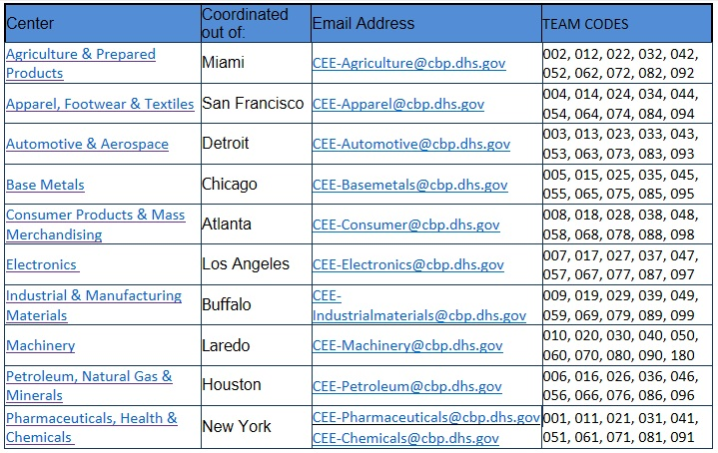
Centers, Teams, and Emails
Telephone: 866-295-7624
12

Slide 13
More information – www.cbp.gov
Centers on the Web:
  http://www.cbp.gov/trade/centers-excellence-and-expertise-information
Center Federal Register Notices:
  http://www.gpo.gov/fdsys/pkg/FR-2013-04-04/pdf/2013-07840.pdf
  http://www.gpo.gov/fdsys/pkg/FR-2012-08-28/pdf/2012-21217.pdf
  http://www.gpo.gov/fdsys/pkg/FR-2014-03-10/pdf/2014-05115.pdf
13

Slide 14
Customs and Border Protection
Our Mission
We are the guardians of our Nation’s borders.
We are America’s frontline.
We safeguard the American homeland at and beyond our borders.
We protect the American public against terrorists and the instruments of terror.
We steadfastly enforce the laws of the United States while fostering our nation’s economic security through lawful international trade and travel.
We serve the American public with vigilance, integrity and professionalism.

Slide 15


