Slide 1
Randy Guillot
Triple G Express, Inc.

Slide 2
Safety Moment
U.S. Trucking Industry Overview
Top Legislative Priorities
Current Industry Issues
Driver Employment Challenges

Slide 3
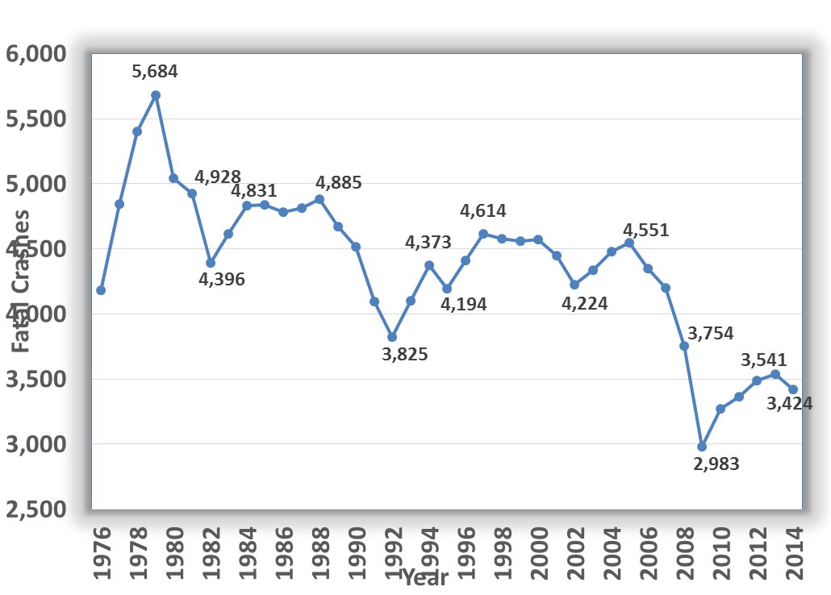

Slide 5
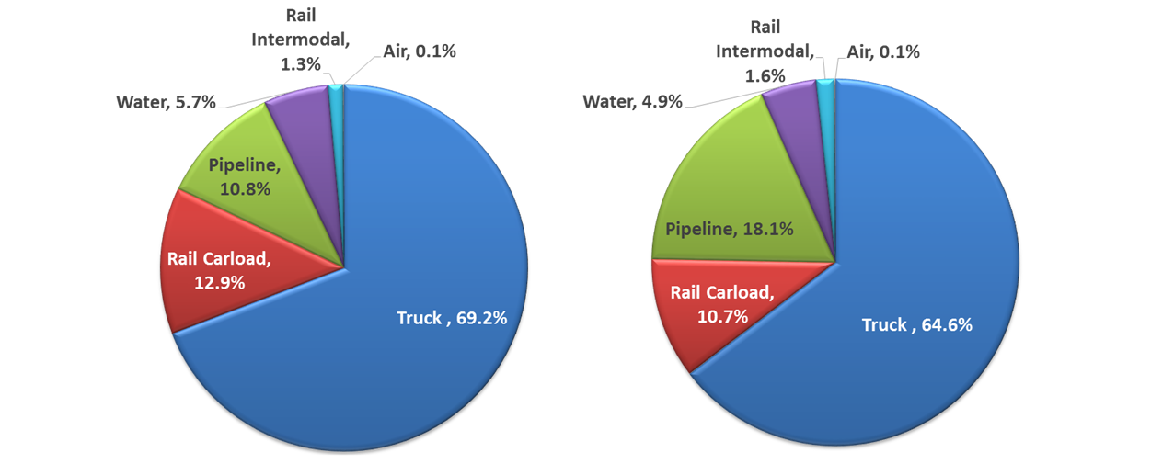
2015
2026

Slide 9
