Slide 1
This is Outokumpu

Slide 2
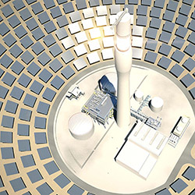
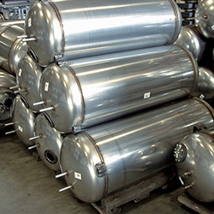
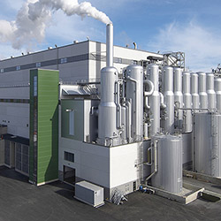
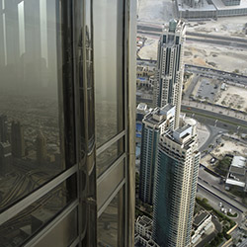
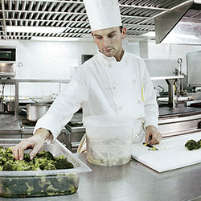
Stainless steels are everywhere and for almost every need
Energy
Chemical industries
Heating, cooling & ventilation
Oil & gas
Pulp & paper
Stainless steel is
Strong
Resistant
Formable
Beautiful
Safe
Recyclable
Architecture, building & infrastructure
Automotive & transportation
Catering, food & beverage
Home appliances

Slide 3
Our vision
To be the best
value creator
in stainless steel
by 2020 through
customer orientation
and efficiency.
5/26/2016

Slide 4
Our operations
Avesta
Tornio
Kemi
Degerfors
Sheffield
Nyby
New Castle
Krefeld & Benrath
Calvert
Dillenburg
Wildwood
Richburg
Dahlerbrück
San Luis Potosí
Integrated melt shop, hot and cold rolling
Other mills
Mine
Service center
Our turnover 2015 (m€): 6,384
11,000 professionals in more than 30 countries.

Slide 5
Safety is our number one priority in all operations
Our safety principles
Safety starts with me.
Safety comes before volumes.
No shortcuts.
No repeats.
Lost-time injury target <2.5
Lost-time injury rate 2015 3.0

Slide 6
Listening to our customers helps us focus on the right themes
Other
Product quality
Technical expertise
Easy to deal with
Customer satisfaction drivers
Commercial terms
Delivery reliability
1,197 customer satisfaction interviews during 2015

Slide 7
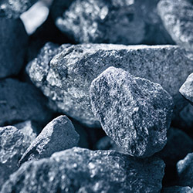
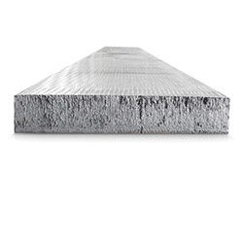
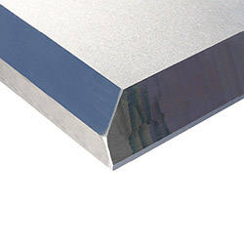
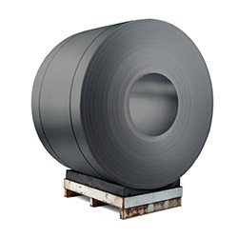
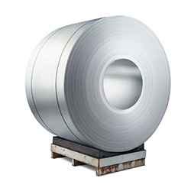
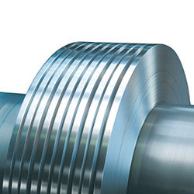
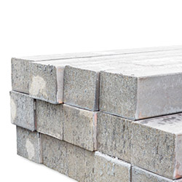
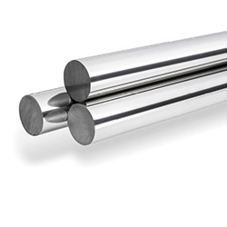
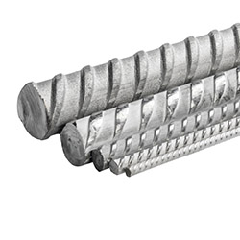
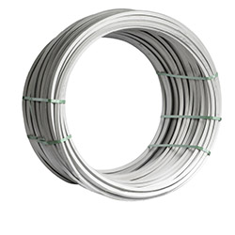
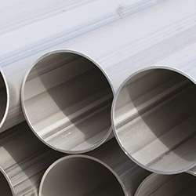
Our product forms
Ferrochrome
Slab
Quarto plate
Hot rolled black coil
Hot and cold rolled white coil
Precision strip
Cast semis
Rolled and forged billet
Bar
Rebar
Wire rod
Welded pipe

Slide 8
Working towards forever.
We work with our customers and partners to create long lasting solutions for the tools of modern life and the world’s most critical problems such as clean energy, clean water, and efficient infrastructure. Because we believe in a world that lasts forever.
5/26/2016

Slide 9
SOLAS COMPLIANCE

Slide 10
SOLAS IMPLEMENATION

Slide 11
SOLAS CHALLENGES

Slide 12
Thank you!
www.outokumpu.com
choosestainless.outokumpu.com
Subscribe newsletter: www.outokumpu.com/newsletter
Twitter: twitter.com/outokumpu
Facebook: www.facebook.com/OutokumpuGroup
LinkedIn: www.linkedin.com/company/outokumpu
Youtube: https://www.youtube.com/outokumpu

