Slide 1
SOLAS – Shippers Point of View
Andrew Hooser
May 2016

Slide 2




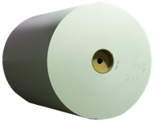

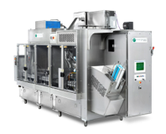
Leading Positions in Product Segments
Evergreen Packaging maintains leading positions in each of its major product categories, deriving over 70% of its net sales from product segments where it is the #1 or #2 supplier.
Position in Key Product Segments
($ in millions)
North America
Global
Asia
Latin America
Notes:
Evergreen Packaging maintains leading positions in each of its major product categories, deriving over 70% of its net sales from product segments where it is the #1 or #2 supplier.

Slide 3
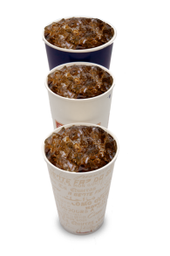







Packaging and Paper Product Segments
Liquid Packaging
Board
Cupstock
PET board
Cartons
Spouts
Printing
Papers
Envelope
Papers
Equipment
Notes:
Our mills produce a diverse number of coated and uncoated paper, liquid packaging board, cupstock and PET board for ovenable trays. In addition our converting facilities produce cartons for a number of national food and beverage brands, as well as local and regional companies. Our equipment divisions in Cedar Rapids and Shanghai produce filling equipment for the beverage industry, and through our sister company, CSI, we market the spouts for cartons as well. All in all, a diverse set of products that are found in the majority of US households.

Slide 4




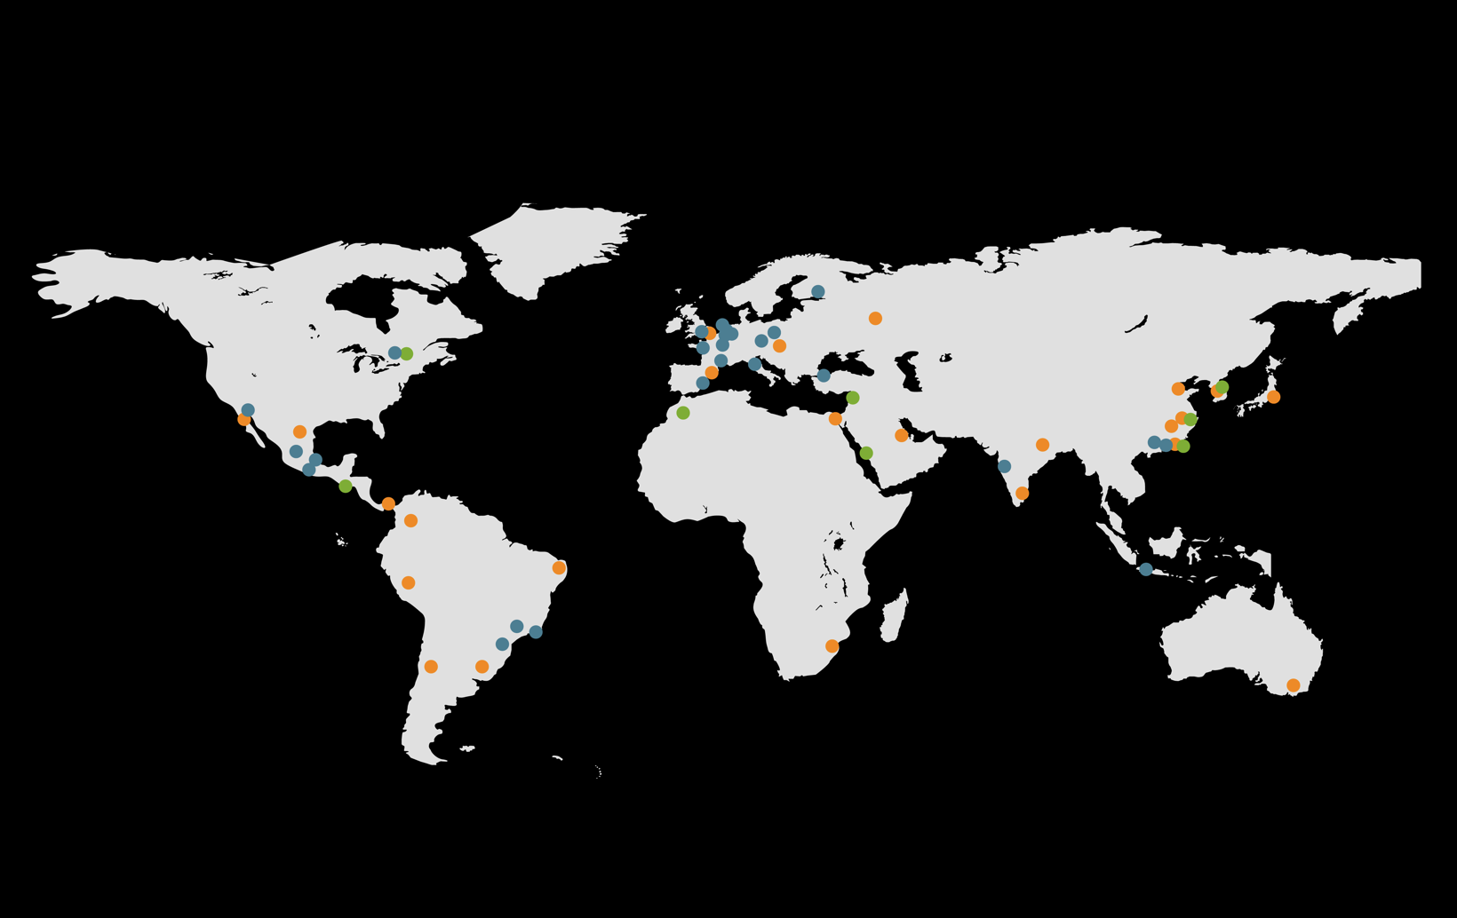
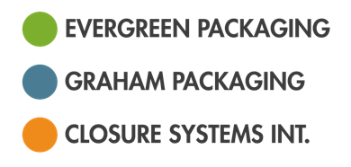
US and Global Footprint – “NuCo”
Overview
14,000 Employees
127 Facilities
29 Countries
$6 Billion in Revenue

Slide 5
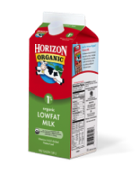
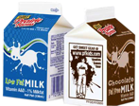




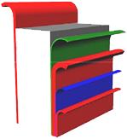








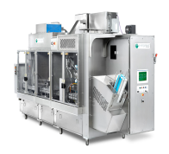
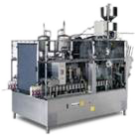
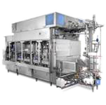
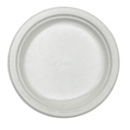
Evergreen Packaging Products
Fresh Beverage Packaging
Paper and
Specialty
North American
Packaging
International
Packaging
Packaging
Board
  Printing and Advertising
  Specialties
Broad range of highly decorated cartons
Consumer packaging /
cotton swabs
Envelopes
Multi-layer liquid
packaging board
Convenient re-closable spouts
Cupstock
Paper bags
Magazines /
catalogues
Ovenable trays
Multi-speed packaging machines
Platestock
Evergreen’s key products include proprietary fresh carton sleeves in a broad range of sizes, specially designed re-closable spouts, multi-speed packaging machines and multi-layer packaging board with complex barrier properties

Slide 6


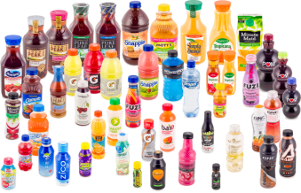
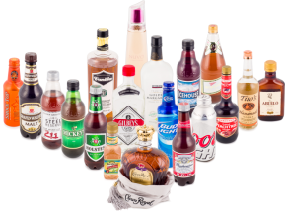
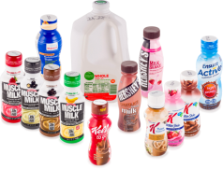
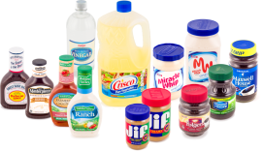

Closure Systems International Products
Carbonated Soft Drinks
Bottled Water
Non-Carbonated Beverages
Dairy
Adult Beverages
Food
Auto

Slide 7
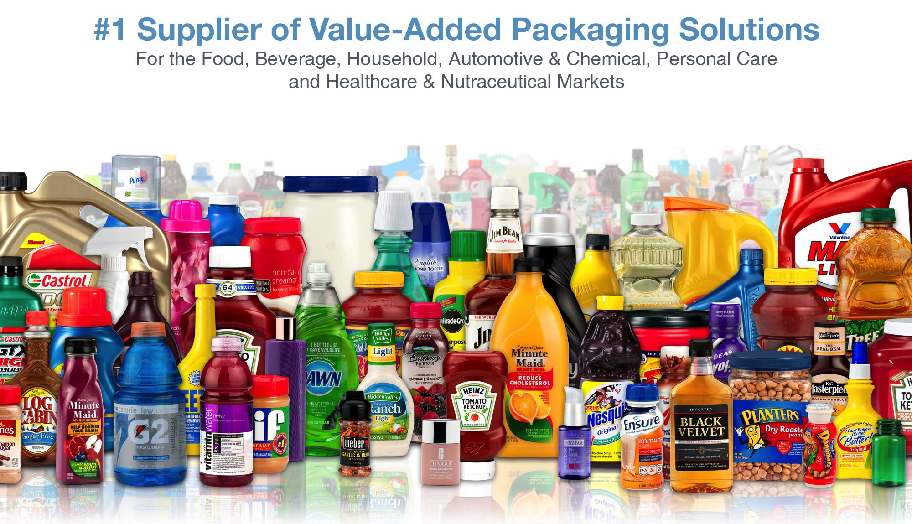
Graham Packaging Products

Slide 8
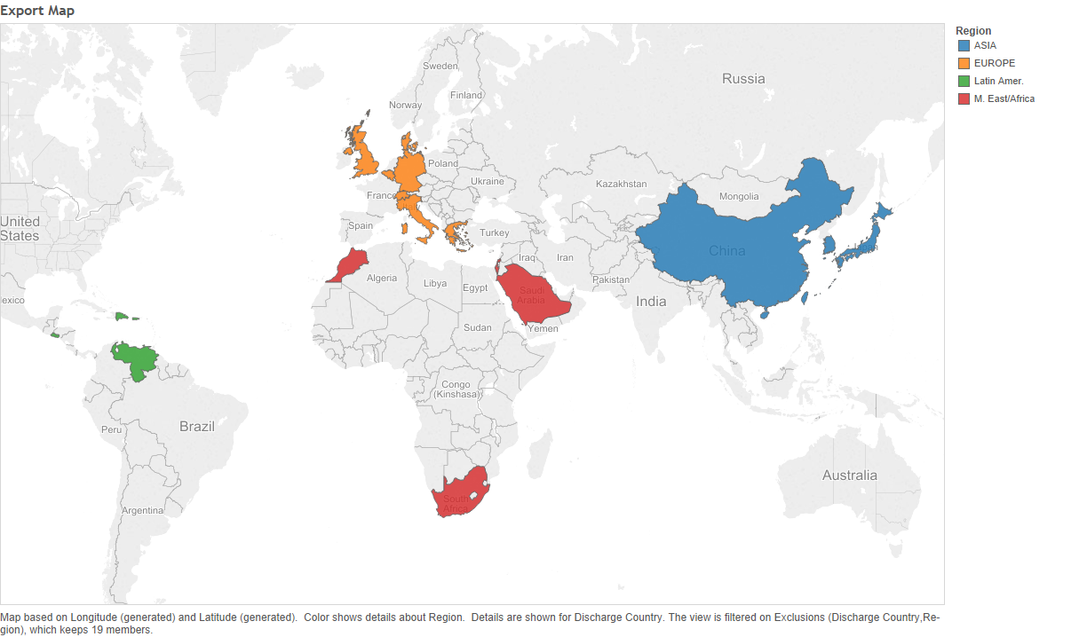
Export Map

Slide 9
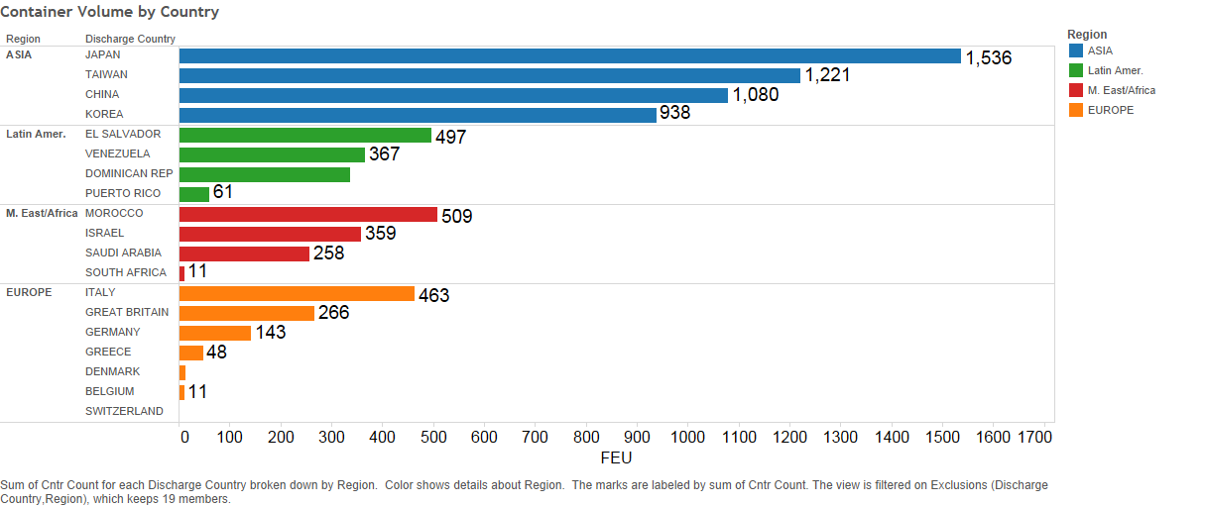
Export Volume (FEU)

Slide 10
IMO/OCEMA SOLAS Guidelines of Submitting Weight
Method 1 – Weigh the Container
Method 2 – Shipper Weighs Contents of Container and Adds Tare Weight

Slide 11

Method 1 - Weigh the Container
Exciting!!!
HOS/Elogs/Driver Shortage
WC Port Congestion
Chassis Management
Decaying Infrastructure

Slide 12
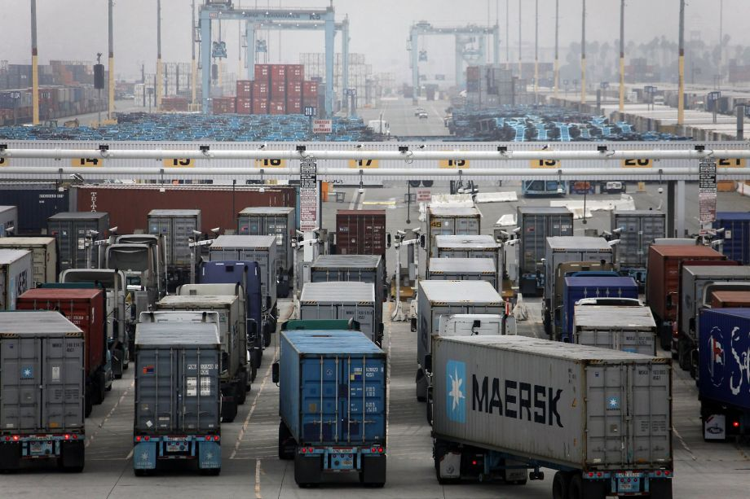
Method 1 - Weigh the Container
Requires Shipper/Drayman/Port to take on full burden
Administratively Difficult
Physically Impossible?/Difficult Without Infrastructure Investment

Slide 13

Method 2 – Shipper Provide Tare Weight + Cargo Weight
Confusing

Slide 14
Method 2 – Shipper Provide Tare Weight + Cargo Weight
Administrative/Physical
  Loaders must record weights (Accurately!)
  When will weights be submitted?
  What about products that gain/lose weight in transit?
  What happens if a container is placed on the rail to an on dock terminal without weight?
IT
  We have not programmed for this
  How do we do it?
Legal
  Shippers certify weights of equipment they don’t own?
  What happens if the shipper records incorrect weight?
  What is the weight variance tolerance?
More Questions than Answers – Less than 45 Days Away!

