Slide 1
Committee of 100 for Economic Development
IFFCBANO Conference 2015
www.C100LA.org

Slide 2
Louisiana’s Opportunities Projects
Louisiana has announced more than $80 billion in new projects and expansions
Louisiana ranks #1 in business climate and #1 for exports in the US
Louisiana’s business taxes are the most competitive in the nation for new manufacturing projects

Slide 3
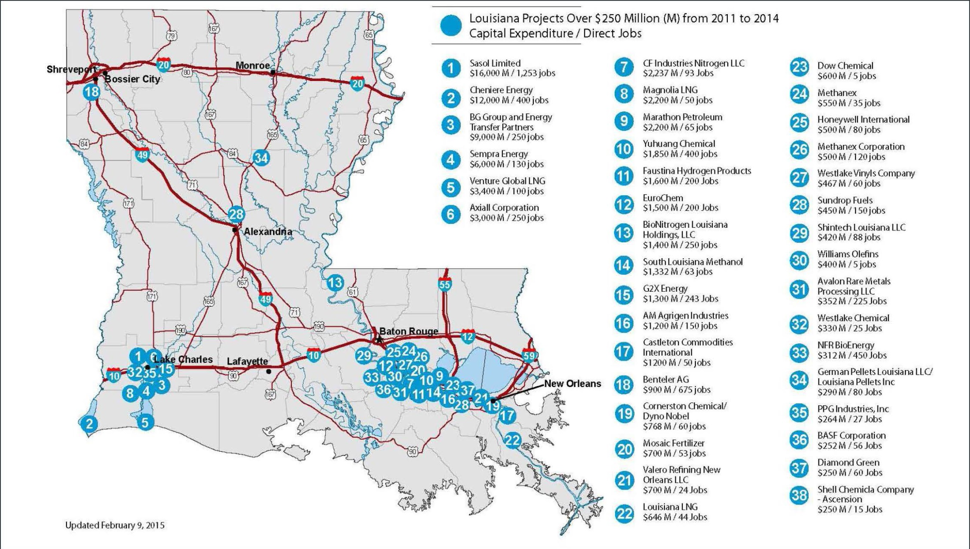

Slide 4
Louisiana's Opportunities Announced new/expansion projects
Past: Good year = $5 billion
Recent Survey: $80+ billion!
Highly concentrated by industry
Chemicals - $75 billion
Highly concentrated geographically
Lake Charles MSA: $52.5 billion
BR/NO River Region: $21.5 billion

Slide 5
Challenges / Trends

Slide 6
Regulatory Reform
Current annual cost of US regulatory system is $1.8 trillion
35% of major regulations (compliance costs over $100 million) issued without required public comment period
Although required by law, many agencies do not perform cost-benefit analyses
Permitting process must be simplified, streamlined, and accelerated

Slide 7
Fiscal Reform
Size of federal government should be between 18-20% of GDP. Currently at 74% of GDP and expected to exceed 100% by 2035
A debt equal to 100% of GDP means that 100% of the annual U.S. economic output would be needed to pay off the debt
In the US, 10 million jobs are needed to get back to 5% unemployment

Slide 8
National Workforce Trends
For every job open in the U.S. two people are actively looking for work. This ratio was nearly 7:1 in 2009
US has a jobs shortfall of 5.8 million (number of jobs needed to keep up with growth in potential labor force)
US needs 258,000 jobs per month to reach 2007 labor market levels by July 2017

Slide 9
Aging Workforce
Older workers (age 55+) are about to overtake younger workers (age 25-34) for the first time
By 2020 almost 20% of the U.S. population will be over 65 years old
69% of Boomers anticipate working past traditional retirement age

Slide 10
Louisiana’s Opportunities Workforce
It is expected that Louisiana will net 40,000 new jobs every year over the next several years as a result of this economic growth
Louisiana will need about 98,000 employees working in STEM fields by 2018
In 2014 Louisiana employment reached 2 million for the first time in history

Slide 11
Louisiana’s Opportunities Workforce
Louisiana will need more than 98,000 skilled craft workers through 2018 to meet the needs of these projects
In addition, Louisiana will need about 250,000 total workers to support the boom in economic expansion

Slide 12
Louisiana’s Opportunities Workforce
It is estimated we can recruit about 50,000 current residents in need of some type of training to fill the new jobs
Louisiana currently has the capacity to train 64,000 workers

Slide 13
Issue: Job Readiness
80% of workplace reading requires critical thinking and an articulate written or verbal response
Data show fewer than 30% of four-year college graduates excel in these skills

Slide 14
Issue: Skills Gap
60% of job openings require basic STEM literacy
42% require advanced STEM skills
38% of employers indicate that at least half of new entry-level employees lack basic STEM literacy

Slide 15
Addressing the Skills Gap
Raise the bar in K-12 standards to improve core skills in math, reading, science, and problem-solving
Help boost STEM training (core sciences, engineering, math, data analytics, financial services, cybersecurity)
Match foundational worker skills to available jobs

Slide 16
Workforce Now
Louisiana Workforce Commission
Up to 90% wage reimbursement for On-the-Job Training (OJT).
Employers receive reimbursement in order to compensate for the typical hiring/training costs, such as lost productivity, during any new hire’s learning curve.
Qualifications
Employers that are hiring in-demand occupations that pay $10/hr employ at least 2 Full-time workers, carry Worker’s Comp and pay into the Unemployment Insurance
http://www.laworks.net

Slide 17
Workforce Now
LED FastStart
Turnkey workforce solution for new/expanding facilities
Services include employee recruitment and screening, safety and teamwork training, leadership development for managers, and specialized assistance for employees
Training offered in quality, leadership, lean manufacturing, animation and other critical areas, and covers a wide variety of industries such as advanced manufacturing, aerospace, digital media and pharmaceuticals
For companies aligned with targeted industries including Advanced & Traditional Manufacturing, Digital Media, Headquarters & Business Operations, Research & Development, Warehouse & Distribution
Qualifications- create 15 new, permanent jobs for manufacturing or distribution centers or 50 new, permanent jobs for digital media, headquarters, R&D or inbound call center operations.
http://www.opportunitylouisiana.com/page/led-faststart

Slide 18
Workforce Now
Louisiana Job Connection- free job board with a matching system designed to pair you with Louisiana jobs that best fit your skills, experience and education. http://LouisianaJobConnection.com
WISE Program- the state created the Workforce & Innovation for a Stronger Economy (WISE) $40 million fund in 2014 enabling Public Higher Education System institutions to increase degree/certificate production in high demand fields.

Slide 19
Louisiana's Opportunities Higher Education
More than $90 million is being invested in 876,000 square feet of new or improved training facilities at community & technical colleges over the next 3-5 years
Link coursework to industry needs and projected workforce demands
Produce nationally recognized commercial research in the areas of Bio Sciences, Technology and Computer Sciences, Agriculture, Advanced Manufacturing, Engineering and others.

